Slide 1
MALWARE CLASSIFICATION Kaggle MICROSOFT CHALLENGE
BY
MURTUZA SHAREEF [G01024452]
DEEPAK KANURI [G01070295]

Slide 2
Main Idea
Extension of the intrusion detection idea discussed in class.
Malware detection has become really important, because hackers and syndicates use any means necessary to steal information. Thus it is really important to detect and classify the malware, so as to act on it.
In our project, we did not just detect malware, and classified them into 9 families.
We used different classification techniques for this problem-K Nearest Neighbour, Random Forest, XGBoost

Slide 3
Why just .bytes files ?

Slide 4
Featurization and its bottlenecks

Slide 5
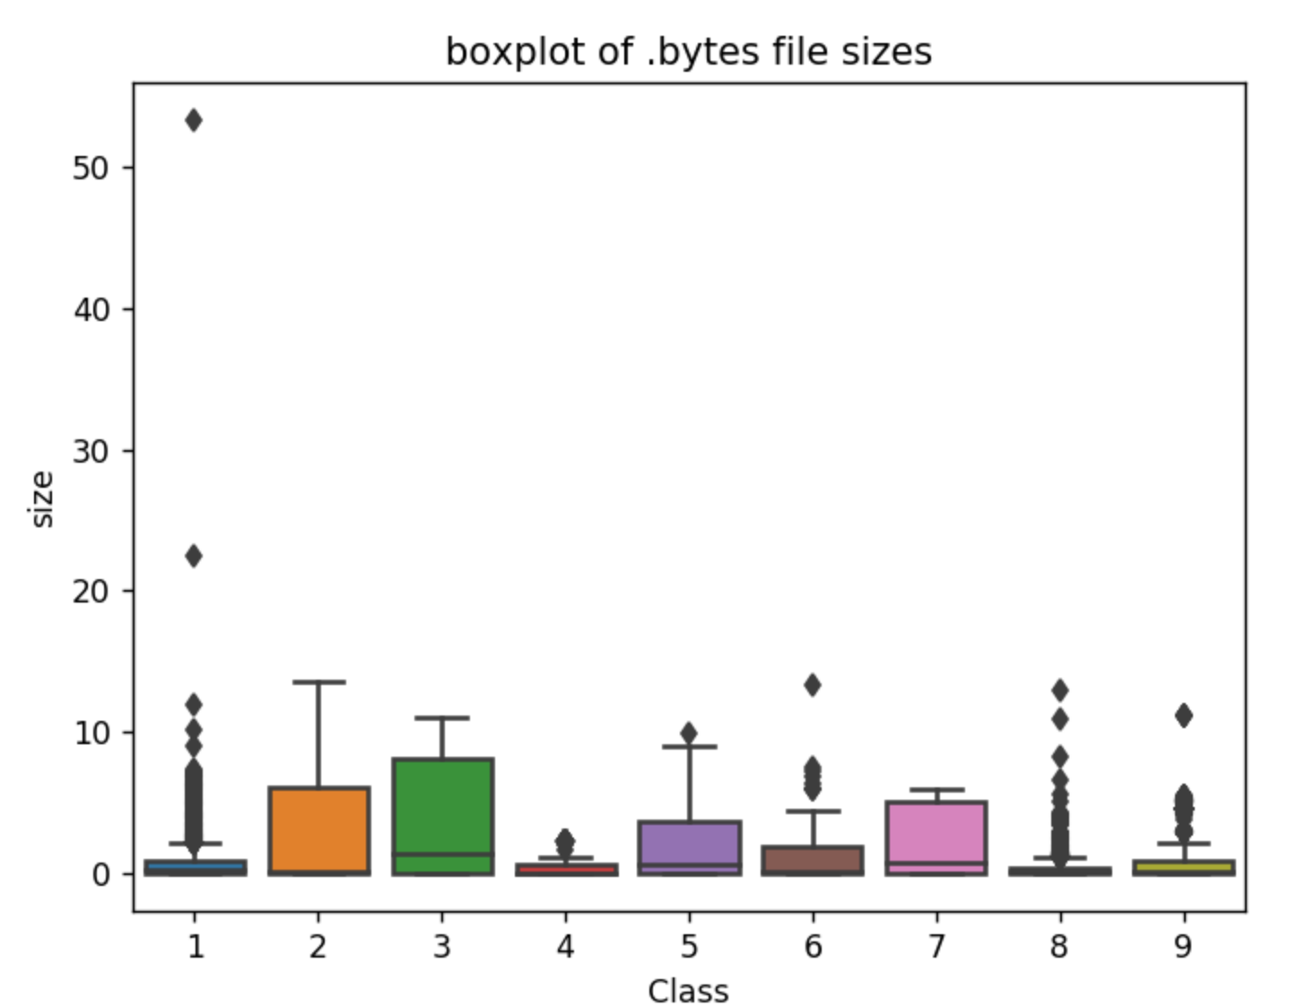
Feature - file size

Slide 6
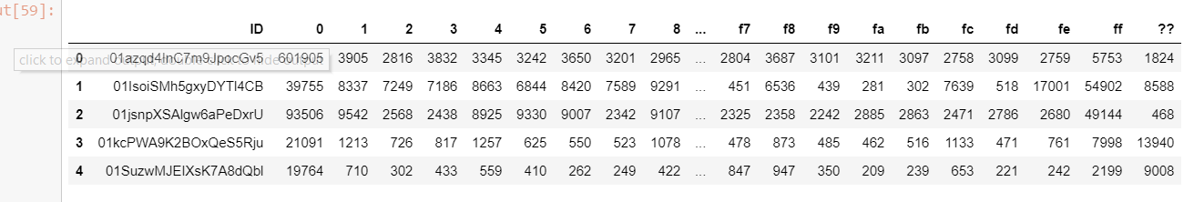
Feature – count vectorizer

Slide 7
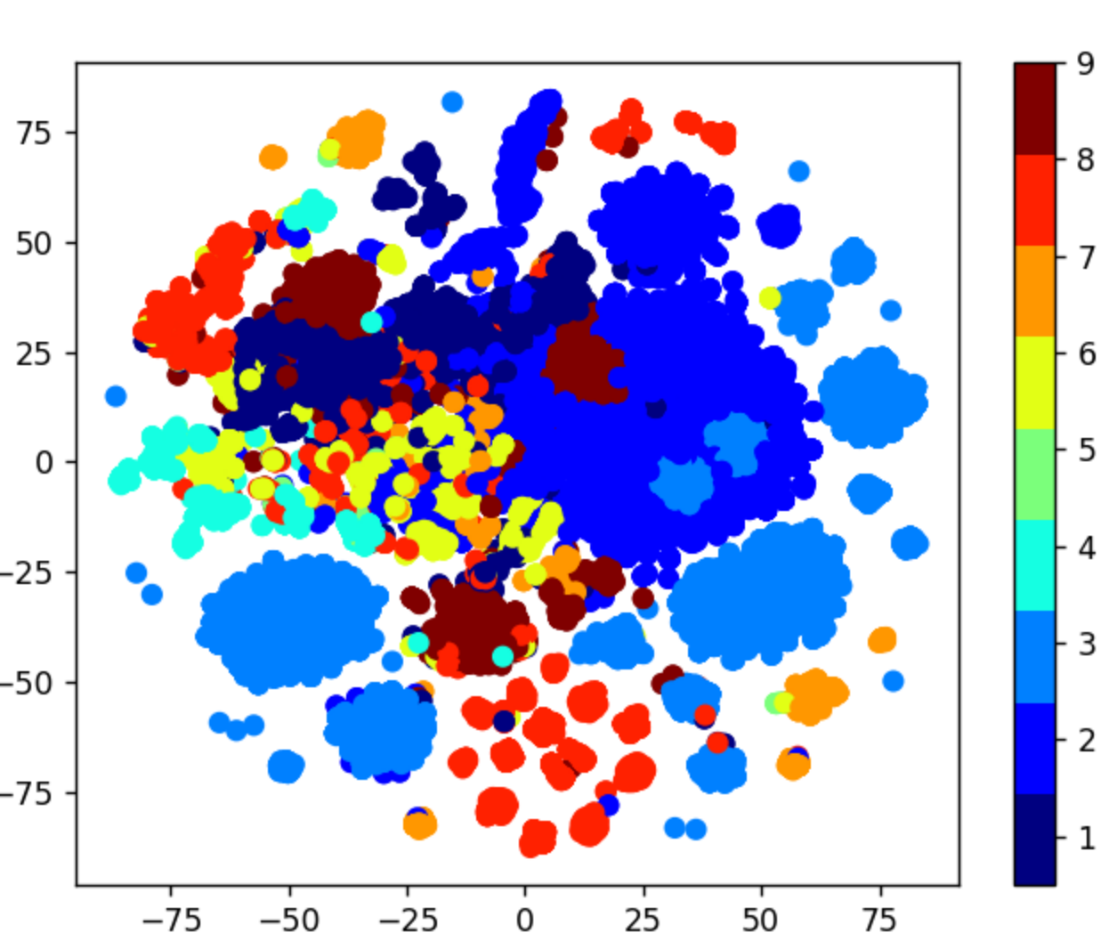
Eda-tsne (for perplexity - 50 ; 30)

Slide 8
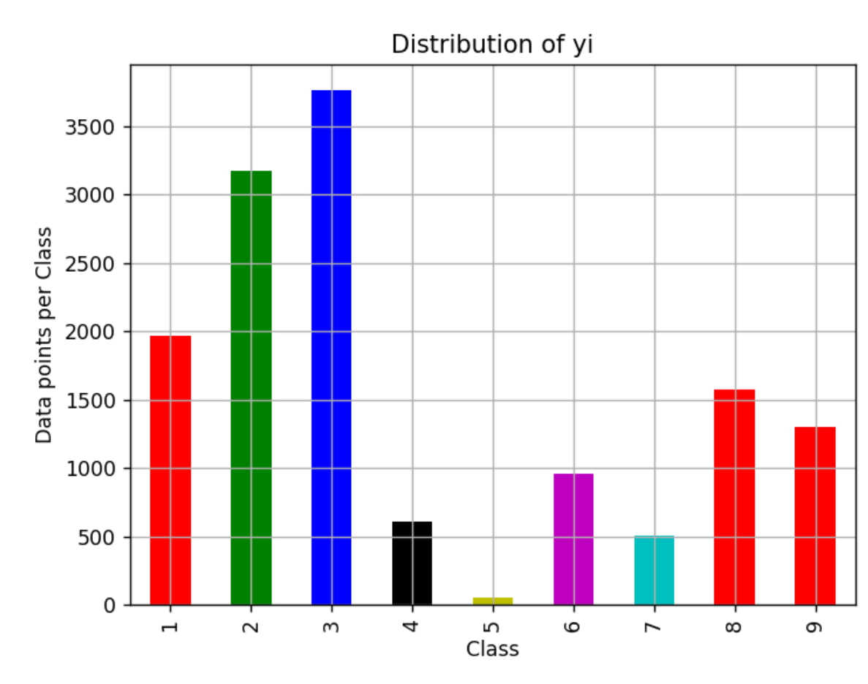
Class-y distribution across Train-test-CV

Slide 9
M.l and the Metrics
Multi-class log loss
Confusion ; Precision and Recall matrices

Slide 10
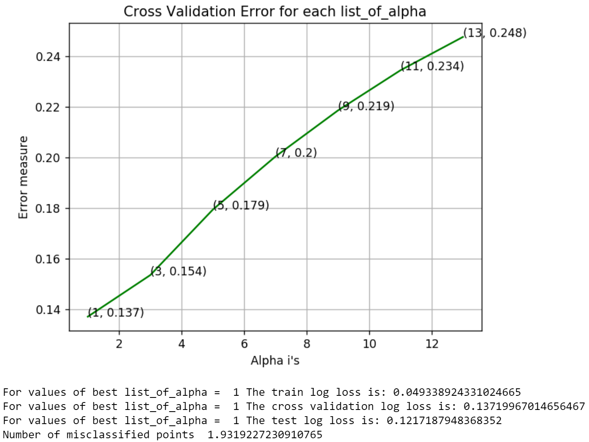
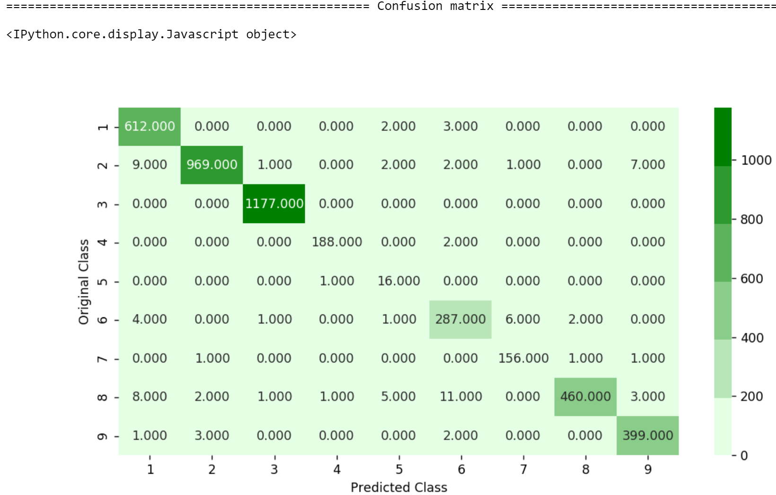
K Nearest neighbour

Slide 11
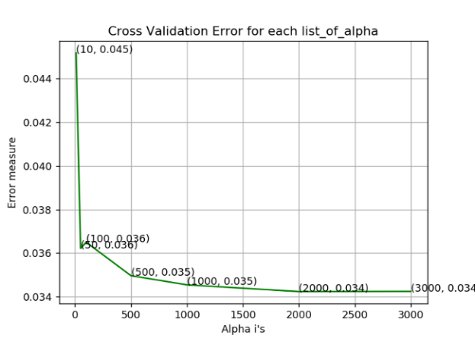
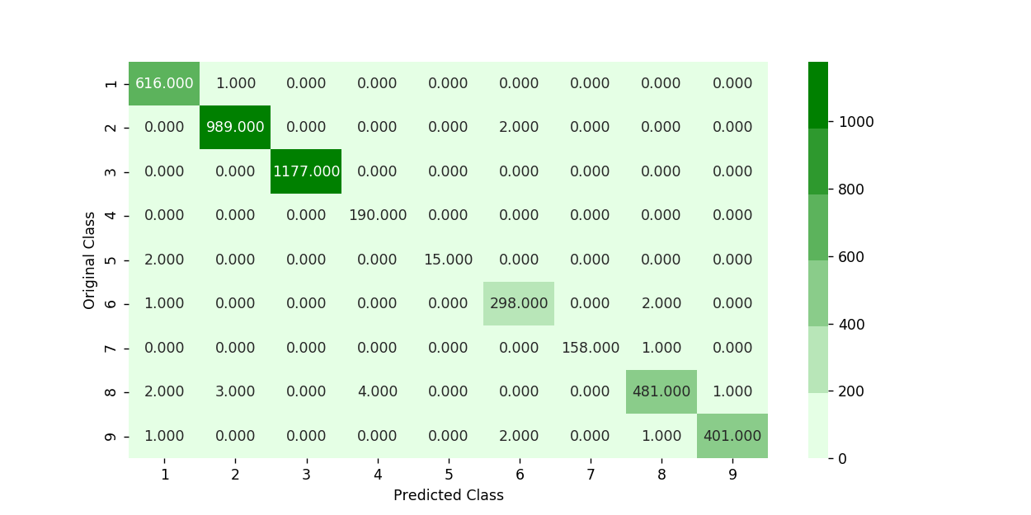
Random forest

Slide 12
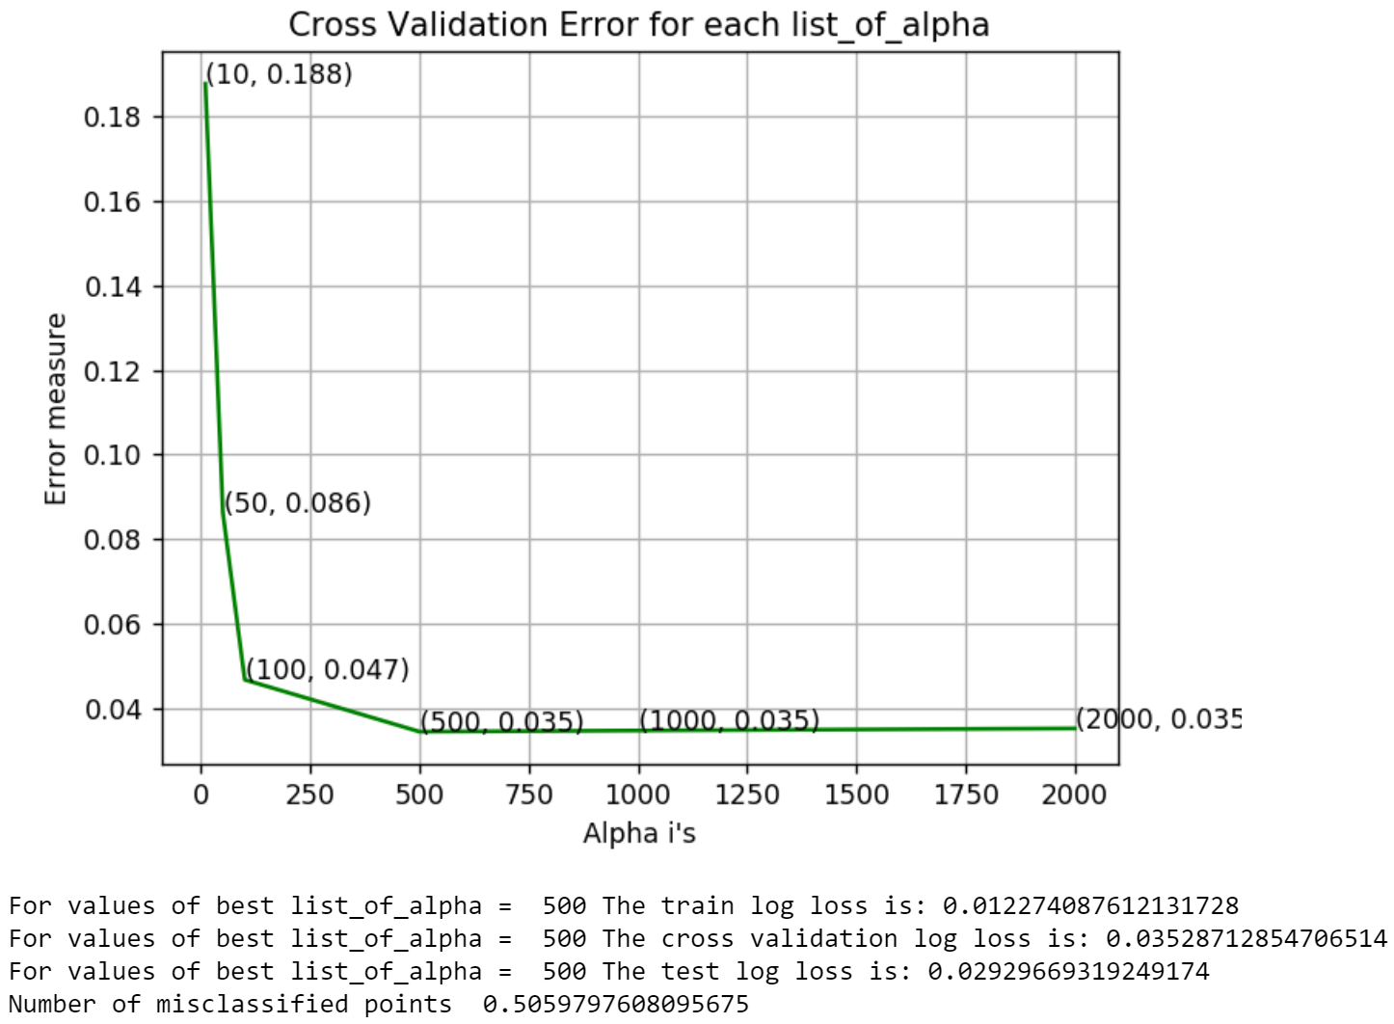
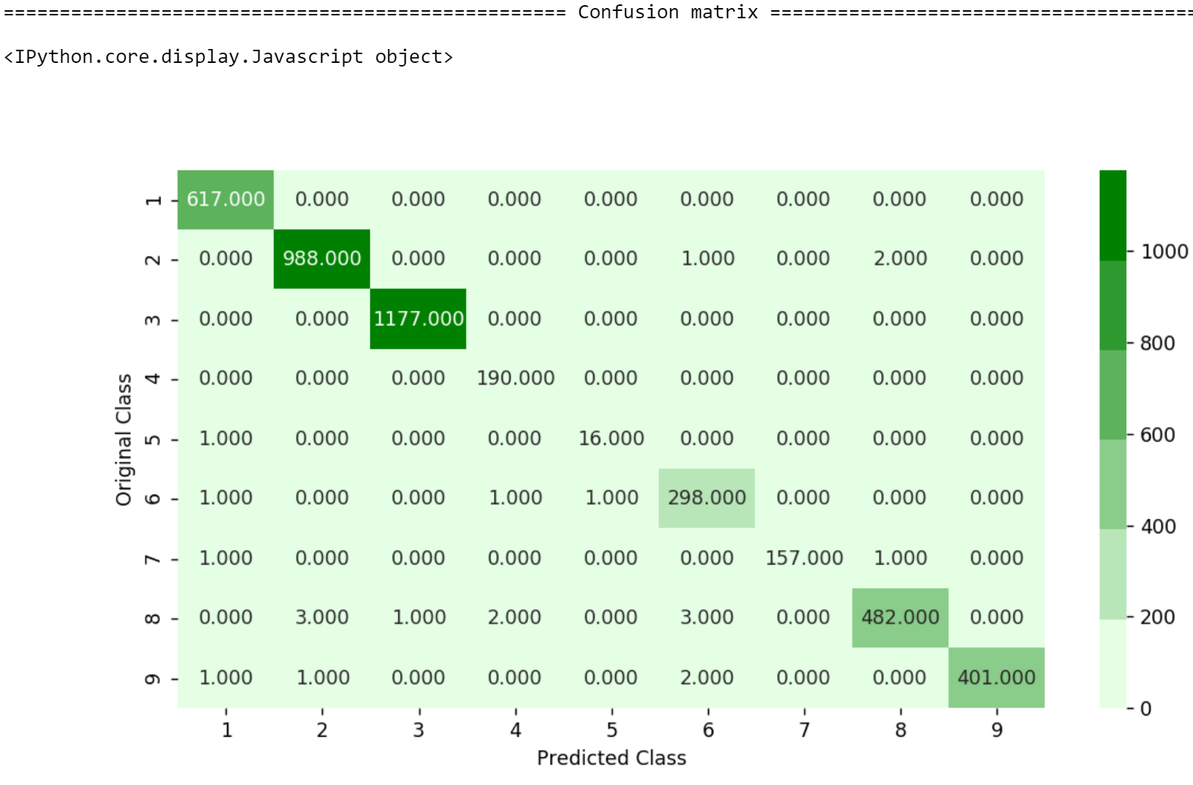
XGBoost

Slide 13
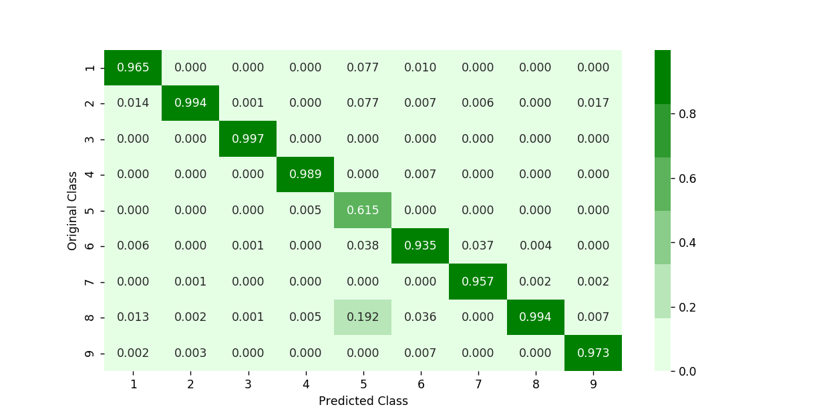
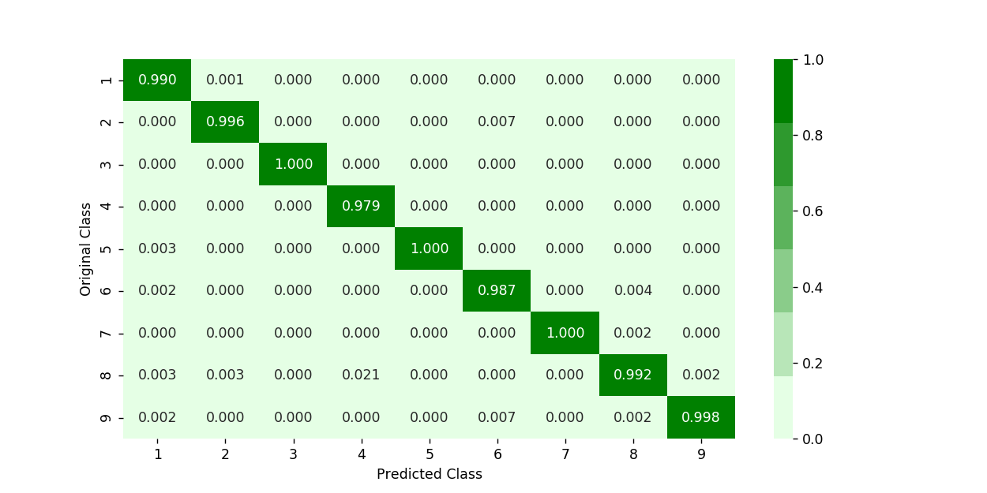

Precision Matrix
K Nearest Neighbour
Random Forest
XGBoost

Slide 14



Recall Matrix
K Nearest Neighnour
RRandom Forest
XGBoost

Slide 15
Conclusion
XGBoost achieves the best results among all the tried algos
Future improvements:
The featurization can be improved on – more sophisticated features could be used to improve the performance of the model.
More complex models – like ensembles can be tried out
Probably deep learning can be applied – if we are treating it as a text classification problem as we already have huge amount of data available.

